Slide 1

Python Course Chapter 1
Data Types

Slide 2
Notes of Chapter 1
In this chapter, we will learn some basic syntax and data types in Python. You are required to memorize some of the rules and syntax.
Before you start coding, make sure that you know that – Python is case sensitive.
Python uses indentation to indicate blocks of codes. (If you have experiences in other programming languages, they usually use a semicolon ; and curly brackets { } to indicate blocks of codes)
When giving indentation, you can use either tab or space. Usually, one tab has the same length as 4 spaces. Make sure your indentation is consistent!! Otherwise, you might see “IndentationError: unindent does not match any outer indentation level.”

Slide 3
Python Data Type
Name | Type | Description | Copy By Reference
Integer | int | Whole numbers, such as -5, 0, 16 | No
Float | float | Numbers with decimal point, such as 10.25, 0.04, 3.14159 | No
String | str | Ordered sequence of characters, such “Aloha” | No
Boolean | bool | Logical value indicating True or False | No
List | list | Ordered sequence of data, such as [12, “Hello”, True] | Yes
Dictionaries | dict | Unordered key-value pairs, such as {“name”: “Wilson”} | Yes
Tuples | tup | Ordered immutable sequence of objects, such as (10, “100”, ”Hello”) | Yes
Sets | set | Unordered collection of unique objects {“a”, “b”} | Yes

Slide 4

Numbers
Numbers are one of the most commonly used data types in Python. There are two types of numbers – integer and float.
Basic number operations include addition, subtraction, multiplication, division, remainder operator (mod), and exponent operator.

Slide 5
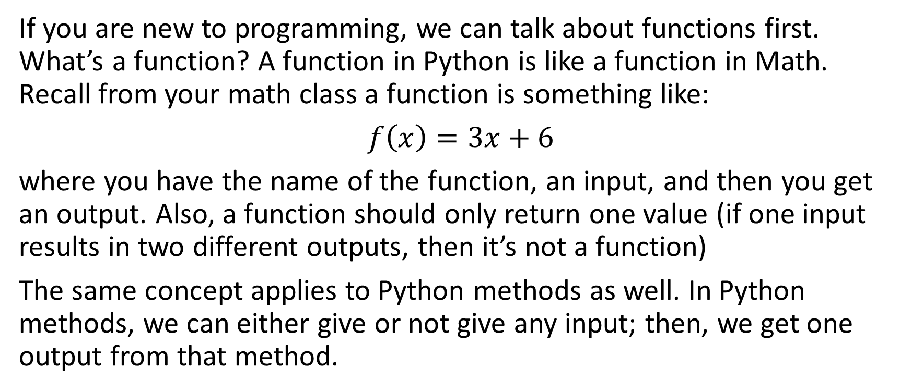
Functions in Python
If you are new to programming, we can talk about functions first. What’s a function? A function in Python is like a function in Math. Recall from your math class a function is something like:
$f\left(x\right)=3x+6$
where you have the name of the function, an input, and then you get an output. Also, a function should only return one value (if one input results in two different outputs, then it’s not a function)
The same concept applies to Python methods as well. In Python methods, we can either give or not give any input; then, we get one output from that method.

Slide 6
Built-in Python Methods for Numbers
Besides arithmetic operations, there are built-in methods for numbers in Python. Some of the common ones are:
abs()
str() *
pow()
max()
min()
round()
int() *
float() *
*. str(), int() and float() are for typecasting.

Slide 7
Math Module
Some other methods require us to use the “Math Module.” What’s the module? Well, we will talk about that later. Now, focus on how to use constants and methods.
Some common constants and methods in the math module are:
e
pi
floor()
ceil()
sqrt()

Slide 8
Variable and Assignment
Variable and assignment are some of the essential concepts in any programming language. Variable is like a container where we store values in. In programming, we can store data into variables using “=. “
Notice that Python = doesn’t have the same concept as the = you use in math!!! In Python, the equal sign is “assignment,” meaning that you want to put the data on the right-hand side of the equals sign to the left-hand side of the equal sign; therefore, it’s common to do:
x = 5, x = x + 1, print(x)
Now, x is 6.
*. A syntax sugar is to change x = x + 1 to x += 1. This is extremely common in programming.

Slide 9

Strings
A string is an ordered sequence of characters, such “Aloha”.
Some rules to know:
String is ordered, which means we can use indexing and slicing. Indexing starts from 0!!
Single quote ' and double quote " are the same in python, as they can be used in wrapping a string in a string.

Slide 10
String Concatenation
In Python, the new line character “\n” is used to create a new line. When inserted in a string all the characters after the character are added to a new line.
In Python, if we put an addition operator between strings, that means we are concatenating 2 strings.
In Python, we cannot make concatenation on strings and numbers. (This is very common in other languages, but just keep in mind, we cannot do this in Python)
String is immutable!!

Slide 11
Python Built-in String Method I
len()
int()
float()
str()
upper()
lower()
isupper()
index()

Slide 12
Python Built-in String Method II
replace()
split() - create a list from a string by white space
list() - create a list from a string character by character
format()
count()
find()
startswith()
endswith()
*. Keep in mind that Python built-in methods don't modify the string itself.

Slide 13
Other Rules of Strings
Immutability - String in Python is immutable, which means we cannot change it.
String multiplied by numbers is a valid operation! This is very different from other programming languages, but this will save our life eventually.
In Python, we can use the format method and f-string. What’s the difference between string concatenation and format method? They are the same, except that formatting is mainly used for readability.

Slide 14

List
List is an ordered sequence of data, such as [12, “Hello”, True]. List is just like array in other programming languages.
If we have similar or associated data, we can store them in a list instead of putting them individually in memory.
*. List of Lists can be used to represent a matrix.

Slide 15
List
len() can check the length of the list.
Indexing rule from a string can be used in list as well.
count() method can count the occurrences. index() method returns the first index of the object.
set() change list into a set.
List concatenation can be done by using “+.”
List can also be multiplied by integers.
List is mutable. (Remember, strings are immutable.)

Slide 16
Python Built-in Methods for List
insert()
remove()
clear()
sort()
reverse()
append()
pop()
copy() - since list in python is not primitive, we need a way to copy a list

Slide 17
Dictionaries
Dictionary contains unordered key-value pairs, such as {“name”: “Wilson”, “age”: 25}. It’s just like objects in other programming languages. Dictionary is mutable.
Some commonly used Python built-in methods for dictionaries are:
keys()
values()
items()
*. Advanced Information: dictionaries in Python are hashed, which means they are implemented as a hash table, and taking out key-value pairs in a dictionary has constant time complexity O(1) regardless of the size of the dictionary.

Slide 18
(Bonus Section) What can be a key?
What can we use as a key for a dictionary? The restriction is:
The key has to be immutable.
The key has to be hashable.
Integers, float, boolean, string, tuples are immutable and hashable; therefore, they can be used as dictionary keys. Sometimes it would be very convenient to use list as a dictionary key; for example, the latitude and longitude of a map could be a key in dictionary. Python uses tuples to solve this problem. (Tuple is an immutable list, which will be discussed later)

Slide 19

(Bonus Section) What can be a key?
Another restriction is “The key has to be hashable.”
Python dictionary implements a data structure called hashtable; therefore, if the key cannot be hashed, we cannot get the corresponding value. (In fact, we can implement the __hash__() method to create hashed value of our own defined class.)
Therefore, it’s essential to use immutable objects as a key to ensure the hashed value of the key never changes.

Slide 20
Tuples
Tuples are ordered immutable sequence of objects, such as (10, “100”, ”Hello”). In short, tuples are just immutable list; also, tuples use parenthesis. Therefore,
len() can check the length of tuples.
Indexing rule from string can be used in list as well.
count() method can count the occurrences. index() method returns the first index of the object.
set() work with tuples as well.
Since tuples are immutable, some list methods don't work with tuples, such as pop, append, sort, and so on.

Slide 21
Tuple Packing and Unpacking
Tuple is such a common data type in Python that Python supports 2 features for a tuple:
Tuple Packing
Tuple Unpacking
Tuple packing means Python will automatically pack data that are separated by comma into a tuple. Tuple unpacking means assigning individual elements (separated by comma) of a tuple to multiple variables.
*. Tuple unpacking is an extremely common tool to use in machine learning and data science. Make sure you remember this skill.

Slide 22
Sets
Set is an unordered collection of unique objects, such as {“a”, “b”, 20}. Any hashable object can be an element in a set. People who built Python learned discrete math and implemented the concept into Python; therefore, the set concept that you learned from discrete math applies to the Python set as well. For example, {1, 2, 1} set is the same set as {1, 2}.
Some built-in methods for sets are:
add()
clear()
copy()
discard()

Slide 23
Sets
Since this set idea is from discrete math, there are methods like:
difference() - returns the difference of two or more sets.
intersection() - Returns the intersection of two or more sets as a new set.(i.e. elements that are common to all of the sets)
isdisjoint() - This method will return True if two sets have a null intersection.
issubset(), issuperset()
union()

Slide 24
Boolean
In programming, we often need to know if something is True or False. For example, supposed we are building a ticketing system for a movie theater. If the customer’s age is less than 8, it’s free; else, the price is $300.
In Python, a Boolean is a data type with two possible values: True or False. Make sure they start with an uppercase letter!!
*. Why do they have to start with an uppercase letter? Most reviewers agree that consistency within Python is more important than consistency with other languages. Therefore, almost all built-in constants in Python are capitalized. That’s why. Read https://docs.python.org/3/library/constants.html for more details.

Slide 25
Comments in Python
It’s always a good practice to leave comments in your code. The reasons are:
It helps you understand what your code does. (You might know it pretty well right now, but you will probably forget it after a few months.)
It helps your coworker understand your code. Programmers usually work with a team, instead of building something on their own.
It helps anyone else on the internet understand your code. (If you push them to GitHub)
*. In VS Code, just select codes, and do press Ctrl + / (or command + / in Mac).

Slide 26

Type Checking
When declaring variables in Python, we don’t have to specify the types (In Java or C, you must declare the data type when you declare a variable); therefore, it might be hard to know the current data type of a variable.
In Python, there's a built-in type checking function called type() that returns the data type of the input.

Slide 27
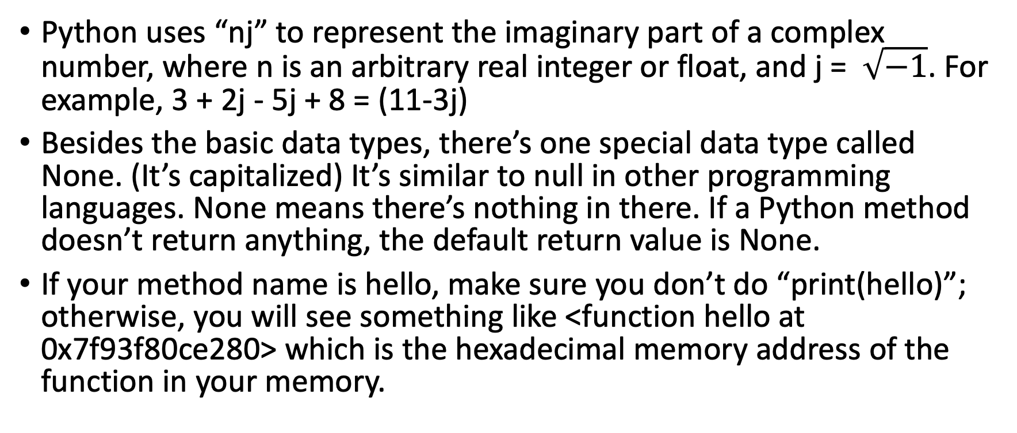
Additional Information
Python uses “nj” to represent the imaginary part of a complex number, where n is an arbitrary real integer or float, and j = $\sqrt{−1}$. For example, 3 + 2j - 5j + 8 = (11-3j)
Besides the basic data types, there’s one special data type called None. (It’s capitalized) It’s similar to null in other programming languages. None means there’s nothing in there. If a Python method doesn’t return anything, the default return value is None.
If your method name is hello, make sure you don’t do “print(hello)”; otherwise, you will see something like <function hello at 0x7f93f80ce280> which is the hexadecimal memory address of the function in your memory.

Slide 28
Additional Information
What’s the value of 0.1 + 0.2 – 0.3? You might think it’s 0, but it’s actually 5.551115123125783e-17. It’s because of the floating binary problem, which is out of the scope of this course.
Python is an object-oriented programming language, meaning that objects control everything. An object can have some behavior in real life, such as a car can go, a dog can bark, or a phone can ring. The same concept applies to Python data. Numbers, strings, lists, dictionaries, and other data types are all objects in Python.
The Python String join() method takes all items in an iterable and joins them into one string. This method is helpful to generate strings from a list, tuples, and sets.

Slide 29
Copy by Value or Reference
In Python, the value assigned to a variable is either copied by value or by reference.
Copy by value means copying the value and getting a whole new object; then, the object is put into the variable. On the other side, copy by reference means we copy the reference of the object in the memory, and the reference is put into the variable.
Integers, floats, booleans and strings are copied by value.
Sets. tuples, lists and dictionaries are copied by reference.
*. The copy() function of dict, set, list can be used to create a new copy of data in memory. However, tuple is immutable; therefore, we must use deepcopy() function to copy a tuple.

Slide 30
Sort and Sorted
How can we sort immutable data types in Python? We only know that list has a built-in method called “sort” that sorts the list ( and it will modify the list in memory directly, since list is mutable).
However, how can we sort dictionaries, sets, tuples or even strings? There’s no built-in method to sort all these data types. Traditionally, we have to sort all those data type manually (sorting algorithms are taught in algorithm and data structure class).
Python introduced a new built-in method called “sorted()” that builds a new sorted list from an iterable without modifying the original data.
*. If you want to sort a list without modifying the original one, use sorted() method.

Slide 31
Membership Operator in Python
Python’s membership operators test for membership in a sequence, such as strings, lists, tuples, dictionaries and sets.
*. Without the membership operator, you might have to use some algorithm to know if an element is in a sequence, which is more tedious.
Name | Description
in | Evaluates to true if it finds a variable in the specified sequence and false otherwise.
not in | Evaluates to true if it does not find a variable in the specified sequence and false otherwise.

